Slide 1
The state of Observability in .NET
Tracing .NET applications in production
Gergely Kalapos Elastic

Slide 2
Gergely Kalapos (Gergö, Greg) Web: http://kalapos.net Twitter: @gregkalapos
Works on observability and performance monitoring tools at Elastic
Loves OpenSource, works in a distributed team
Co-organizer of https://dotnetstammtisch.at
Born in Hungary, lives in Austria

Slide 3
Slides and sample code
https://bit.ly/2T7xQom
Twitter: @gregkalapos

Slide 4
Agenda
What is observability?
Tools in practice: Application Insights, Elastic APM, Jaeger
Manual Instrumentation
DistributedTracing
OpenTelemetry
DiagnosticSource, Activity,

Slide 5
Goals
Overview about the observability landscape in .NET for developers
Standards
Open Source libraries
Be able to research and decide what you need in order to have observability for your production system

Slide 6
Non-Goals
Overview about a single product
Giving a tutorial-style talk about a single product

Slide 7
Demo application
DbService (.NET Core)
Database
Browser
Frontend (.NET Core)
fixer.io (http)

Slide 8
Demo - Sample app

Slide 9
A system is observable when you can ask arbitrary questions about it and receive meaningful answers without having to write new code or command line tools.
It lets you discover unknown-unknowns and debug in production.

Slide 10
3 Pillars of Observability

Slide 11
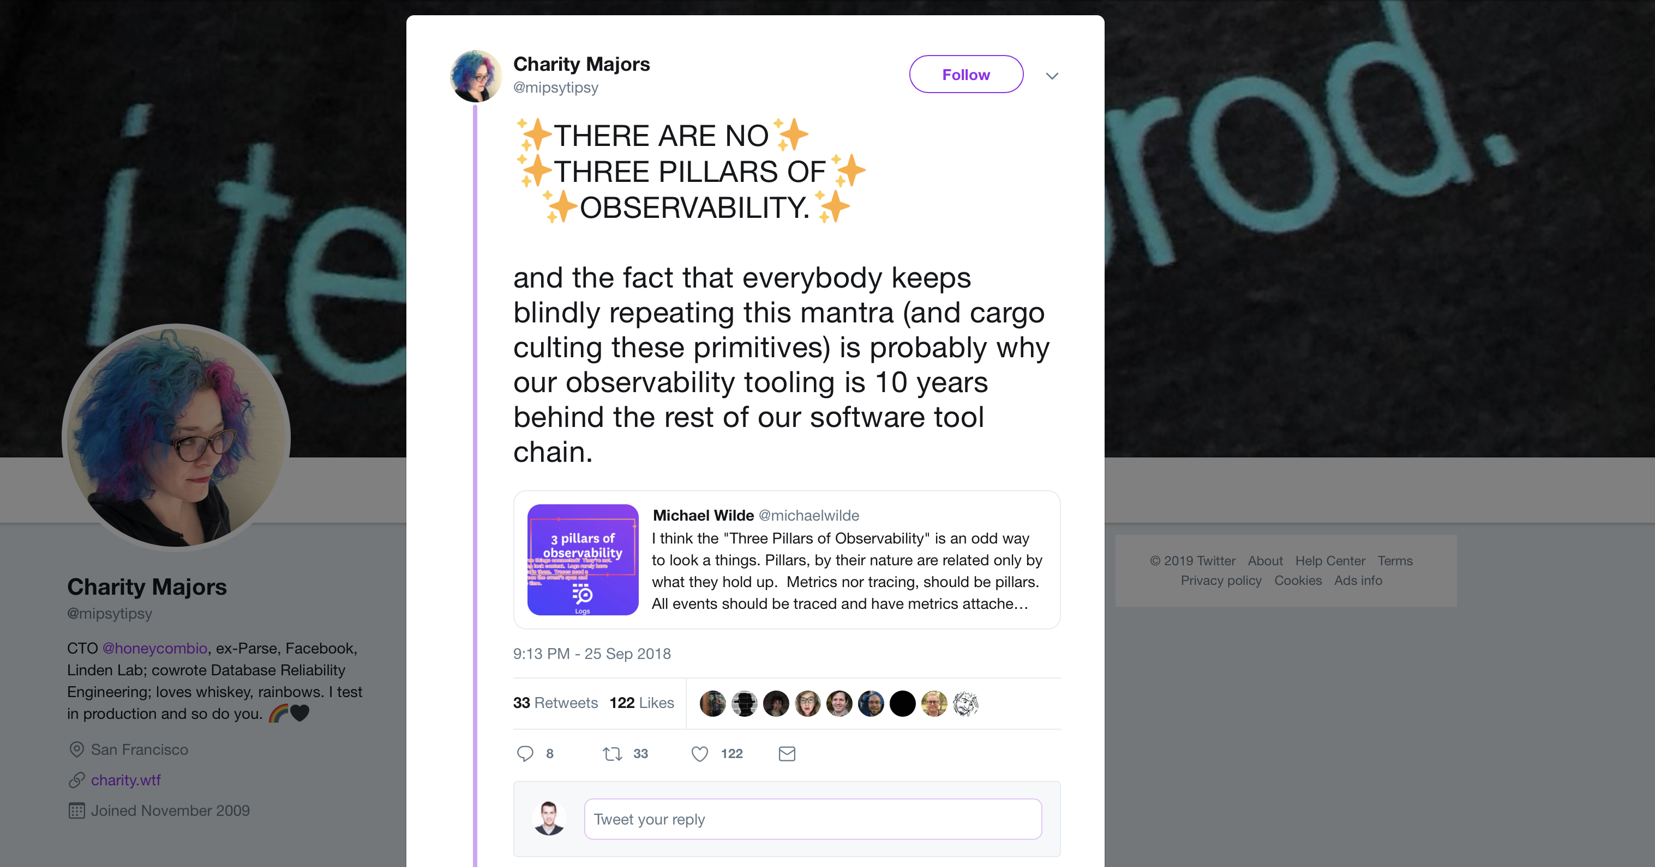
3 Pillars of Observability
Source: https://twitter.com/mipsytipsy/status/1044666259898593282?lang=en

Slide 12
Pillar or not, I honestly don’t care, just show me all logs and metrics to a specific trace!

Slide 13
Demo

Slide 14
Manual code instrumentation

Slide 15
What about things that are not captured automatically?
Manual Insturmentation

Slide 16
Manual Instrumentation Application Insights
TelemetryClient
TrackDependency(…)
TrackEvent(…)
TrackException(…)
TrackPageView(…)
TrackRequest(…)
TrackTrace(…)

Slide 17
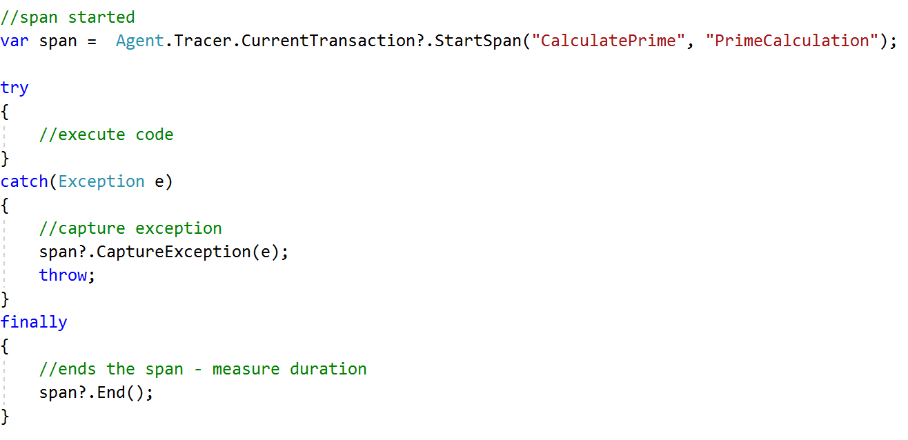
Manual Instrumentation ElasticApm

Slide 18
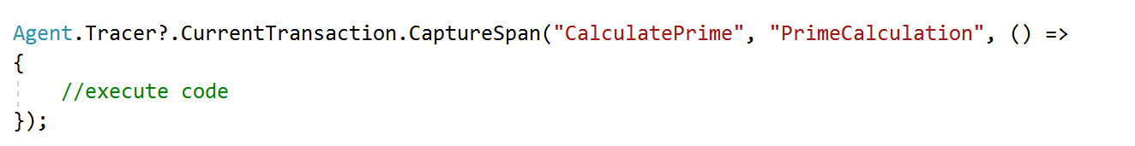
Manual Instrumentation ElasticApm

Slide 19
Demo

Slide 20
Distributed Tracing

Slide 21
Distributed tracing Monolith
Application (1 process)
Database

Slide 22
Distributed tracing Micro-services
Frontend
Db1
Serv.1
Serv.5
Db4
Serv.2
Serv.9
Serv.6
Serv.3
Db2
Db3
Serv.7
Serv.8
Serv.4

Slide 23
Distributed tracing
Browser - HTTP Call
Currency.Frontend
fixer.io (3rd party API)
Currency.DbService
Database

Slide 24
Distributed tracing
Time
Browser - HTTP Call
Currency.Frontend
Spans
fixer.io (3rd party API)
Currency.DbService
Database
Spans in 1 trace belong the same trace ID

Slide 25
Distributed tracing Micro-services
Frontend
Db1
Serv.1
Serv.5
Db4
Serv.2
Serv.9
Serv.6
Serv.3
Db2
Db3
Serv.7
Serv.8
Serv.4

Slide 26
Distributed tracing Micro-services
Frontend
Db1
Serv.1
Serv.5
Db4
Serv.2
Serv.9
Serv.6
Serv.3
Db2
Db3
Serv.7
Serv.8
Serv.4

Slide 27
Distributed tracing Micro-services
Frontend
Serv.1
Observability tool
Serv.2
Serv.7
Serv.8
Serv.9

Slide 28
Communication between services
HTTP
Binary
Message Queues
…

Slide 29
HTTP - W3C TraceContext
GET /service2/getdata HTTP/1.1
Host: www.example.com
Traceparent: 00-c722a7ff47ddc649be8148b41a5d8a86-5505aff1e353374c-00
Date: Wed, 25 SEP 2019 17:22:02 GMT
Connection: keep-alive
Content-Length: 0

Slide 30
HTTP - W3C TraceContext
Header Name
Header Value
Traceparent: 00-c722a7ff47ddc649be8148b41a5d8a86-5505aff1e353374c-01
Version
Trace Id
Parent Span Id
Trace Flags
Made by W3C Trace Context Working Group (https://www.w3.org/TR/trace-context/)
Status: W3C Recommendation
Another header: tracestate - enables tracing by using multiple tracing tools from multiple vendors

Slide 31
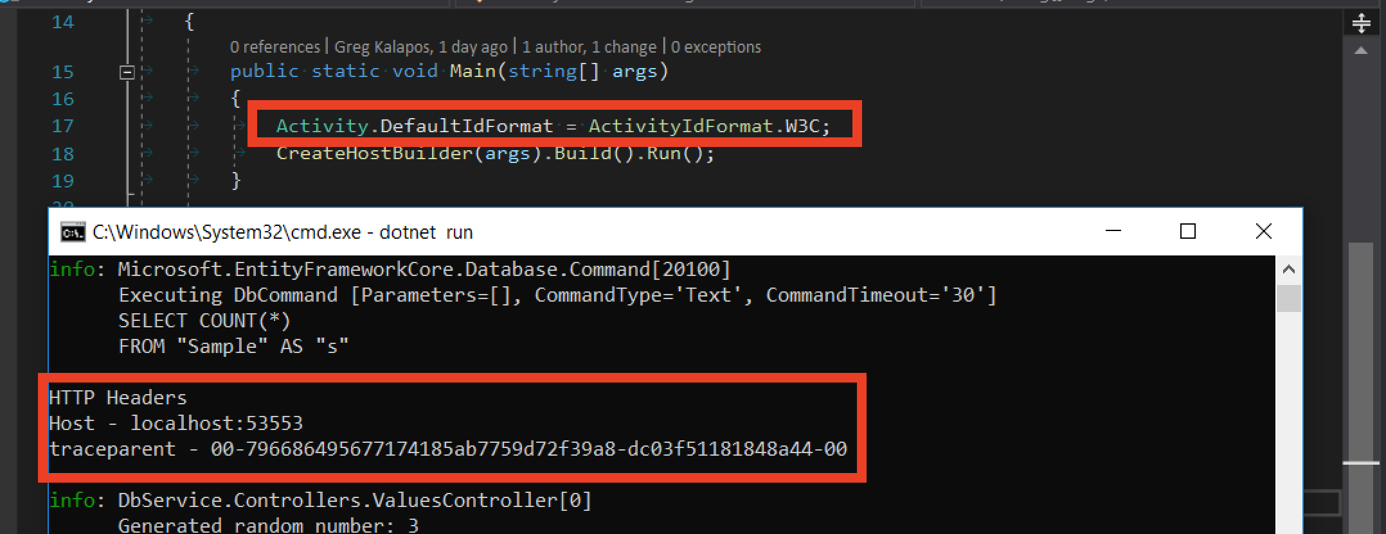
HTTP - W3C TraceContext
System.Diagnostics.Activity: By default it uses its own format (not W3C trace context) (Uses a header called Request-Id)
Since .NET Core 3.0 you can turn W3C format on:
Activity.DefaultIdFormat = ActivityIdFormat.W3C;

Slide 32
Demo

Slide 33
What about non-HTTP?
Elastic .NET Public API
Service1:
Transfer the string `outgoingDistributedTracingData`
over any protocol
Service2:

Slide 34
Demo
Distributed tracing over HTTP a human

Slide 35
OpenTelemetry
Merger of OpenTracing and OpenCensus
CNCF project
Very early stage
Unified set of libraries and specifications for observability telemetry
Avoids vendor lock-in
1 library with multiple output

Slide 36
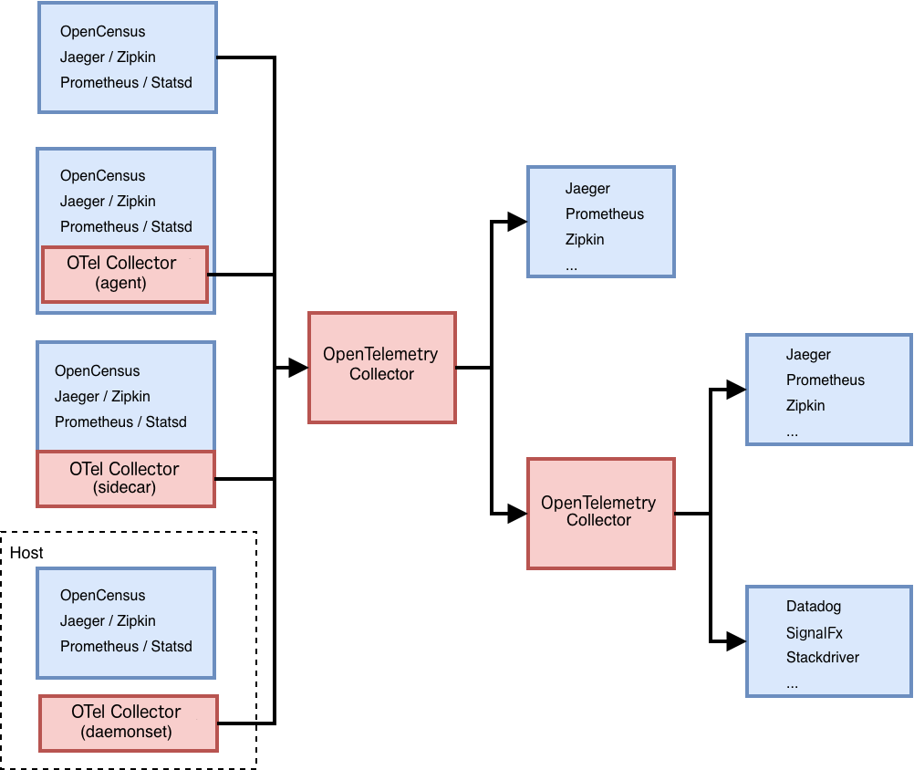
OpenTelemetry Architecture

Slide 37
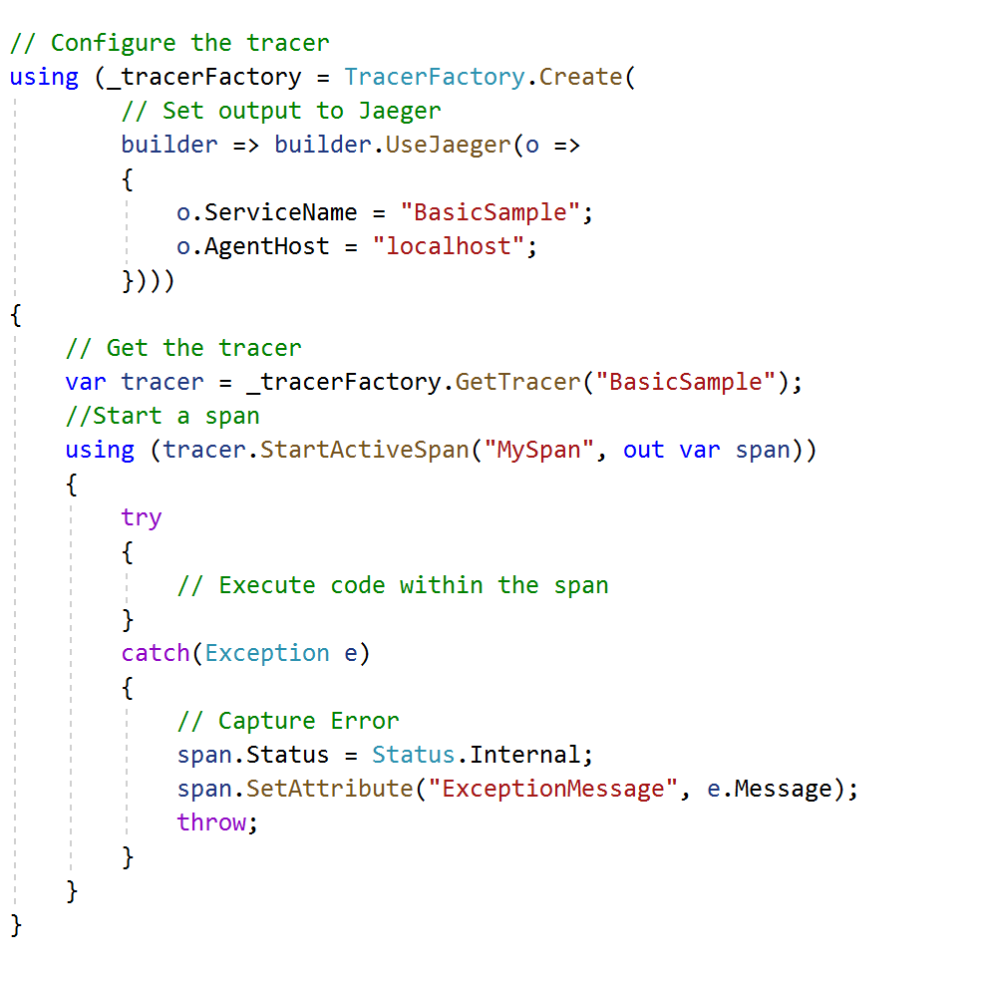
OpenTelemetry .NET
https://github.com/open-telemetry/opentelemetry-dotnet

Slide 38
Demo

Slide 39
How is data automatically captured? DiagnosticSource & Activity

Slide 40
Diagnostic Source
Part of the .NET (Core) Framework (System.Diagnostics.DiagnosticSource)
Instrument code for production time logging of rich data payloads
2 Capabilities:
Write events to it
Listen for events and use the data
Works with objects -> structured data
Create metrics based on it, observability for your system

Slide 41
Instrument with DiagnosticSource
Part 1

Slide 42
class MyLibrary
{
public double CalculateAverage(IEnumerable<double> items)
{
var avgValue = items.Average();
return avgValue;
}
}
private readonly static DiagnosticSource _diagnosticSource = new DiagnosticListener("MyLibrary");
if (_diagnosticSource.IsEnabled("MyLibrary")
_diagnosticSource.Write("CalculateAverageStarted", new { Items = items });
if (_diagnosticSource.IsEnabled("MyLibrary")
_diagnosticSource.Write("CalculateAverageFinished", new { Items = items, Result = avgValue });

Slide 43
Receiver
Part 2

Slide 44
DiagnosticListener.AllListeners.Subscribe(new Subscriber());
class Subscriber : IObserver<DiagnosticListener>
{
public void OnNext(DiagnosticListener listener)
{
if(listener.Name == "MyLibrary")
listener.Subscribe(new MyLibraryObserver());
}
}

Slide 45
class MyLibraryObserver : IObserver<KeyValuePair<string, object>>
{
public void OnNext(KeyValuePair<string, object> kv)
{
switch (kv.Key)
{
case "CalculateAverageStarted":
if (kv.Value.GetType().GetTypeInfo().GetDeclaredProperty(“Items").GetValue(kv.Value) is IEnumerable<double> items)
{
Console.WriteLine("CalculateAverageFinished - items:");
foreach (var item in items)
Console.WriteLine(item);
}
break;
case "CalculateAverageFinished":
if (kv.Value.GetType().GetTypeInfo().GetDeclaredProperty(“Result").GetValue(kv.Value) is double result)
Console.WriteLine($"CalculateAverageFinished - result: {result}");
break;
}
}
}

Slide 46
Demo

Slide 47
DiagnosticSource in HttpClient

Slide 48
Demo

Slide 49
HttpClient - DiagnosticSource
Sends events when the HTTP Request starts and stops
System.Net.HttpRequest/System.Net.HttpResponse: Deprecated
System.Net.Http.HttpRequest.Start/System.Net.Http.HttpRequest.Stop: Based on Activity, use these

Slide 50
DiagnosticSource Used by
HttpClient
ASP.NET Core: Incoming HTTP requests, etc.
MVC: Routing, Controller, Action, etc.
Entity Framework Core: DB Request started, finished, etc.
Lots of Azure libraries

Slide 51
Activity
Store and access diagnostic context
Integrated with DiagnosticSource
Has an ID
Hierarchical - non-root activates have a parent ID
Tags: represents context needed for logging - local to the given activity
Baggage: represents information to be logged with the activity and passed to its children

Slide 52
Activity
var activity = new Activity(“MyActivity");
_diagnostics.StartActivity(activity, new { Property1 = prop1, Property2 = prop2 });
//Do work - normal application/library code
activity.AddBaggage("MyBaggageId", value);
activity.AddTag("MyTagId", value);
_logger.Log(activity.Id);
_logger.Log(activity.ParentId);
_diagnostics.StopActivity(activity,id);

Slide 53
Activity.Current
Points to the currently active activity which flows with async calls and is available during request processing
DiagnosticSource.StartActivity(myActivity): sets myActivity to Activity.Current
DiagnosticSource.StopActivity(myActivity): clears Activity.Current
class MyLibraryListener : IObserver<KeyValuePair<string, object>>
{
public void OnNext(KeyValuePair<string, object> receivedEvent)
{
var currentActivity = Activity.Current;
var tags = currentActivity.Tags;
var id = currentActivity.Id;
var parentId = currentActivity.ParentId;
//…
}
}

Slide 54
Demo

Slide 55
DiagnosticSource & Activity How to put the data to AI/Elastic APM or any other tool?
Elastic APM:
Public Agent API: https://www.elastic.co/guide/en/apm/agent/dotnet/current/public-api.html
Agent.Tracer.StartTransaction()
Agent.Tracer.CurrentTransaction.StartSpan()

Slide 56
class MyLibraryObserver : IObserver<KeyValuePair<string, object>>
{
readonly ConcurrentDictionary<string, ISpan> _concurrentDictionary = new ConcurrentDictionary<string, ISpan>();
public void OnNext(KeyValuePair<string, object> kv)
{
switch (kv.Key)
{
case "CalculateAverage.Start":
var transaction = Agent.Tracer.CurrentTransaction;
if (transaction != null && Activity.Current.Id != null)
{
var span = transaction.StartSpan("CalculateAverage", "MyLib");
_concurrentDictionary.TryAdd(Activity.Current.Id, span);
}
break;
case "CalculateAverage.Stop":
if (Activity.Current != null &&
_concurrentDictionary.Remove(Activity.Current.Id, out ISpan currentSpan))
{
if (kv.Value.GetType().GetTypeInfo().GetDeclaredProperty(“Result").GetValue(kv.Value) is double result)
currentSpan.Labels["Result"] = result.ToString();
foreach (var tag in Activity.Current.Tags)
currentSpan.Labels[$"tag - {tag.Key}"] = tag.Value;
currentSpan.End();
}
break;
default:
break;
}
}
}

Slide 57
class MyLibraryObserver : IObserver<KeyValuePair<string, object>>
{
private TelemetryClient _telemetryClient;
public MyLibraryObserver(TelemetryClient telemetryClient) => _telemetryClient = telemetryClient;
public void OnNext(KeyValuePair<string, object> kv)
{
switch (kv.Key)
{
case "CalculateAverage.Start":
_telemetryClient.TrackEvent("CalculateAverageAsync.Start");
break;
case "CalculateAverage.Stop":
var properties = new Dictionary<string, string>();
if (Activity.Current != null)
{
foreach (var tag in Activity.Current.Tags) properties.Add(tag.Key, tag.Value);
}
if (kv.Value.GetType().GetTypeInfo().GetDeclaredProperty(“Result").GetValue(kv.Value) is double result)
properties.Add("Result", result.ToString());
_telemetryClient.TrackEvent("CalculateAverageAsync.Stop", properties);
break;
default:
break;
}
}
}

Slide 58
Activity vs. direct usage of the library
Shouldn’t we just do this?
class MyLibrary
{
public double CalculateAverage(IEnumerable<double> items)
{
var avgValue = items.Average();
return avgValue;
}
}
var span = Agent.Tracer.CurrentTransaction.StartSpan(nameof(CalculateAverage), "CustomSpan");
try
{
span.Labels["result"] = avgValue;
}
catch (Exception e) { span.CaptureException(e); throw; }
finally { span.End(); }

Slide 59
Activity vs. direct usage of AI/OT etc.
It depends!
Using DiagnosticSource&Activity and bridging - Pros:
Part of the framework - no extra dependency needed
Designed and maintained by Microsoft
Very light-weight and small
No vendor lock-in
DiagnosticSource is there since .NET Core 1.0 and with high probability it won’t go away (other tools sometimes don’t even reach version 1.0)
Using DiagnosticSource&Activity and bridging - Cons:
Additional overhead of the bridging

Slide 60
Summary
Observability tools (Application Insights, Elastic APM, etc): telemetry data from production, correlated logs+metrics+traces
Manual instrumentation in .NET: Activity and DiagnosticSource
TelemetryClient in Application Insights, Public API in Elastic APM: bridge your activities
Distributed tracing, W3C Trace Context: standards for tracing across services
OpenTelemetry: OpenSource library to avoid vendor lock in - not production ready yet

Slide 61
Credit/Resources
Twitter: @gregkalapos
Web: www.kalapos.net
Sample code and slides: https://bit.ly/2T7xQom
Distributed tracing slides/idea - Thomas Watson — An introduction to distributed tracing - https://www.youtube.com/watch?v=g7XSEdriSFM
DiagnosticSourcery 101 - Mark Rendle: https://www.youtube.com/watch?v=g3SZxsskZE
Elastic Apm .NET Docs: https://www.elastic.co/guide/en/apm/agent/dotnet/current/index.html
https://docs.microsoft.com/en-us/azure/azure-monitor/app/api-custom-events-metrics
TraceContext: https://www.w3.org/TR/trace-context/
https://opentelemetry.io

Slide 62
Sample code + Slides
Slides and Sample code: https://bit.ly/2T7xQom
Twitter: @gregkalapos (https://twitter.com/gregkalapos)
Web: www.kalapos.net

